Slide 1
Creating & Training an Artificial Neural Network (ANN)
Notes:
Artificial neural network is a programming structure created to mimic the real brain structure but this network is very much simpler than the actual neural network of the brain.

Slide 2
Overview
In this section we are going to discuss about the concepts of Artificial Neural Network (ANN),forward propagation ,backword propagation, building ANN using Scikit Learn and Keras.
Notes:
Today we are going to talk about the topology of ANN and how to train it to get the weights and the biases. The training will happen using feed forward propagation, feed backward propagation. Also we will build a simple ANN using Scikit Learn and Keras.

Slide 3
Contents
Introduction to ANN
Working of ANN
Training a Neural Network
Types of ANN- Feed Forward and Back Propagation
Building ANN from Scratch (Case Study-Heart Disease Prediction)
Building ANN using Scikit-Learn and Keras

Slide 4
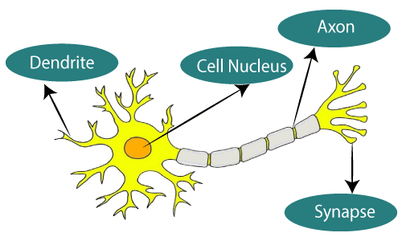
INTRODUCTION TO ANN
In the science of artificial intelligence, an Artificial Neural Network seeks to duplicate the network of neurons that make up a human brain
So that computers can understand things and make decisions in a human-like fashion.
Computers are programmed to behave like interconnected brain cells in the artificial neural network.
Biological Neuron
https://www.javatpoint.com/artificial-neural-network

Slide 5
Working of ANN
Ref: Machinelearningknowledge.ai

Slide 6
TYPES OF ANN
Artificial Neural Networks (ANN) come in a variety of shapes and sizes, and they perform tasks in the same way that human brain neurons and networks do.
There are two types of ANN
Feed forward/ Forward Propagation ANN
A feed-forward network is a basic neural network comprising of an input layer, an output layer, and at least one layer of a neuron.
Feed Back/ Back propagation ANN
The output of this form of ANN is fed back into the network to achieve the best-evolved results internally.
Feedback networks send information back into themselves, making them ideal for solving optimization problems.
Feedback ANNs are used to address internal system errors.

Slide 7
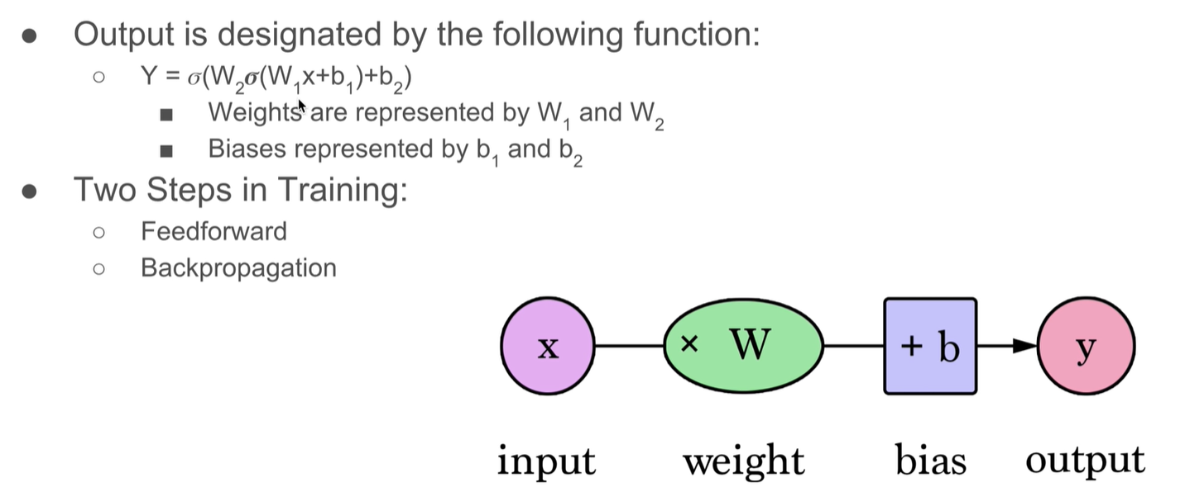
Training a Neural Network

Slide 8
Forward Propagation
The forward propagation can be computed as follows:
Compute the weighted sum between the input and the first layer's weights and then add the bias: Z1 = (W1 * X) + b
Pass the result through the ReLU activation function: A1 = Relu(Z1)
Compute the weighted sum between the output (A1) of the previous step and the second layer's weights—also add the bias: Z2 = (W2 * A1) + b2
Compute the output function by passing the result through a sigmoid function: A2 = sigmoid(Z2)
And finally, compute the loss between the predicted output and the true labels: loss(A2, Y)

Slide 9
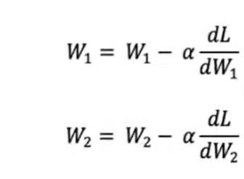
Backward Propagation
After computing the output and loss in the forward propagation layer, you’ll move to the backpropagation phase, where you calculate the derivatives backward, from the loss all the way up to the first weight and bias.

Slide 10
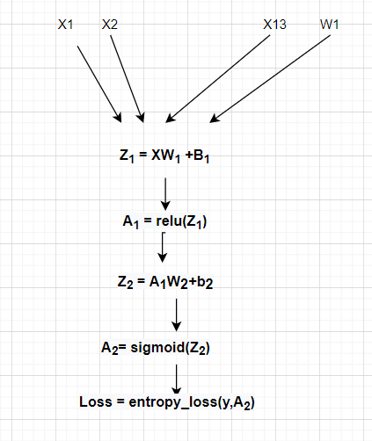
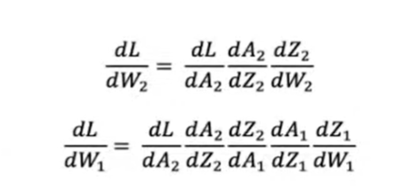
Backward Propagation

Slide 11
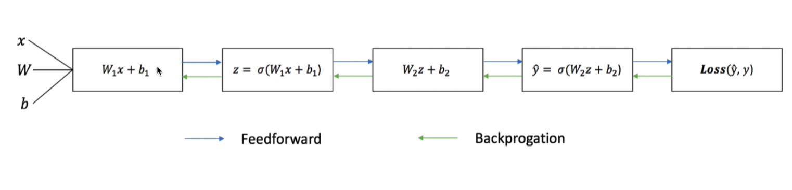
Sequential Flow: Feed Forward & Back Propagation

Slide 12
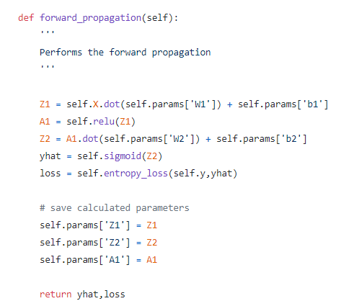
Forward Propagation Definition

Slide 13
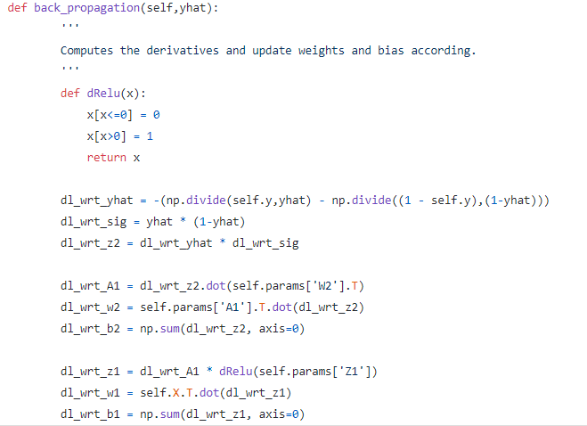
Defining Backward Propagation

Slide 14
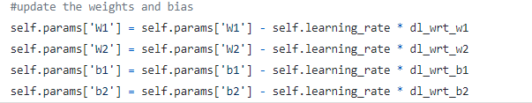
Updating weights

Slide 15
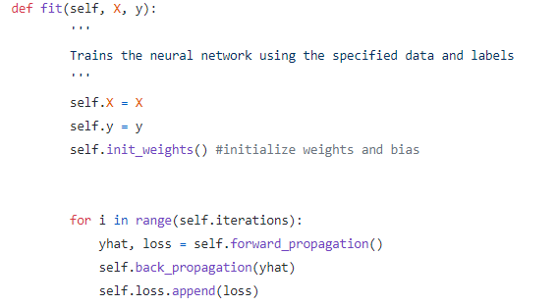
Training of the Neural Network

Slide 16
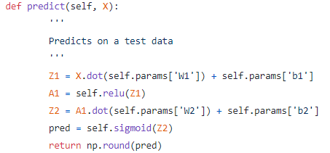
Making Predictions

Slide 17
Build ANN from Scratch

Slide 18
What Are You Trying to Solve?
We are going to create a neural network that predicts if a person will have heart disease or not

Slide 19
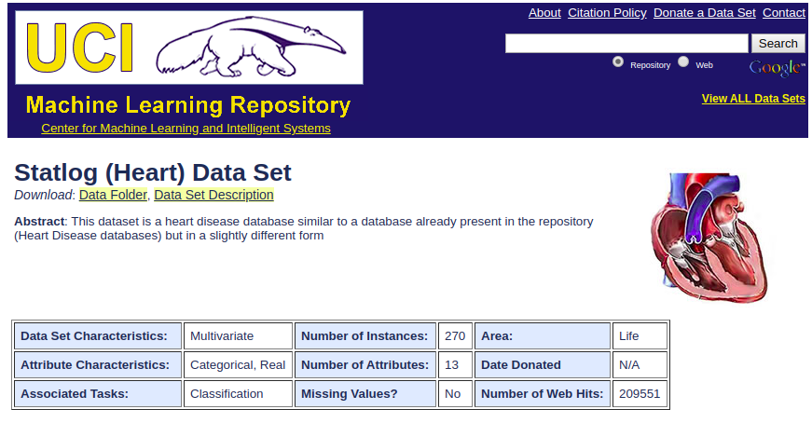
Heart Dataset
UCI Machine Learning Repository: Heart Disease Data Set

Slide 20
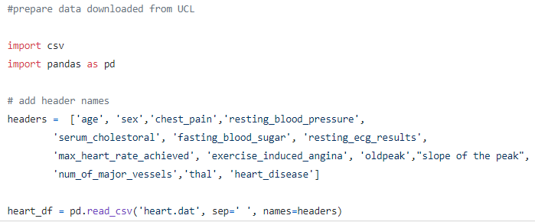
Import Data

Slide 21
Features
The features present in the dataset are:
Age
sex
chest pain type (4 values)
resting blood pressure
serum cholesterol in mg/dl
fasting blood sugar > 120 mg/dl
resting electrocardiographic results (values 0,1,2)
maximum heart rate achieved
exercise-induced angina
oldpeak (ST depression induced by exercise relative to rest)
the slope of the peak exercise ST segment
number of major vessels (0–3) colored by fluoroscopy
thal (3 = normal; 6 = fixed defect; 7 = reversible defect)
heart_disease: absence (1) or presence (2) of heart disease

Slide 22
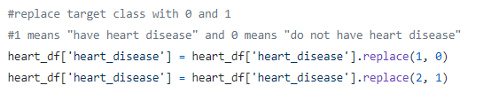
Replace target class to binary

Slide 23
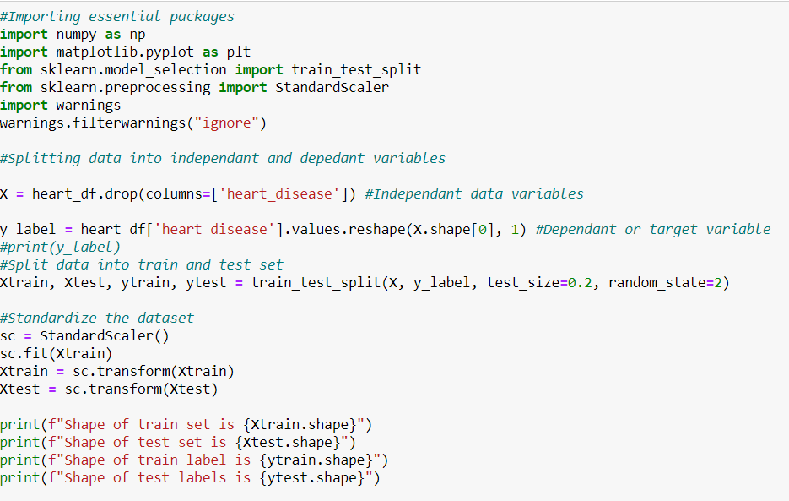
Train – Test Data Split and Standardize

Slide 24
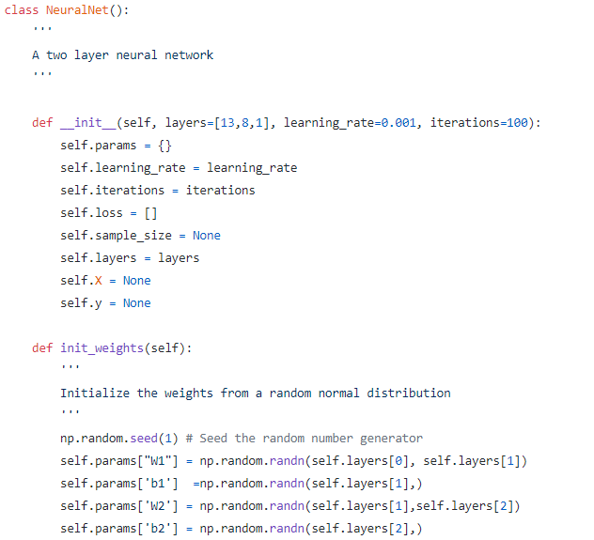
Create a 2-layer Neural Network Class

Slide 25
2-layer Neural Network Class
We created a neural network class, and then during initialization, you created some variables to hold intermediate calculations.
The argument layers is a list that stores your network’s architecture. You can see that it accepts 13 input features, uses 8 nodes in the hidden layer and finally uses 1 node in the output layer.
Moving on to the next code section, you created a function (init_weights) to initialize the weights and biases as random numbers. These weights are initialized from a uniform random distribution and saved to a dictionary called params.
The first weight array (W1) will have dimensions of 13 by 8—this is because you have 13 input features and 8 hidden nodes,while the first bias (b1) will be a vector of size 8 because you have 8 hidden nodes.
The second weight array (W2) will be a 1-dimensional array because you have 8 hidden nodes and 1 output node, and finally, the second bias (b2) will be a vector of size because you have just 1 output.

Slide 26
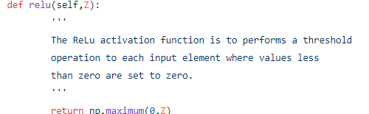
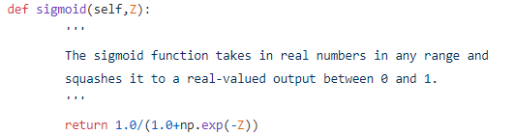
Defining Activation Function
We are using relu and sigmoid

Slide 27
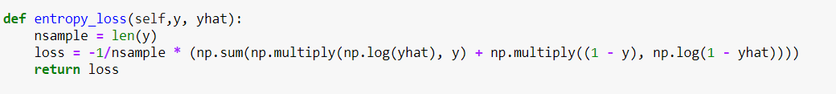
Defining Loss function

Slide 28
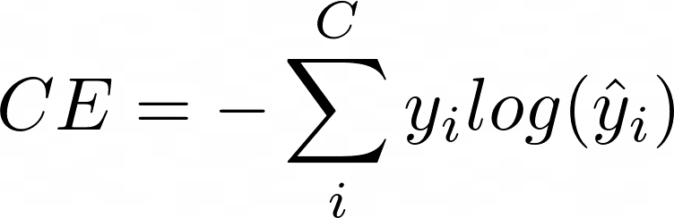
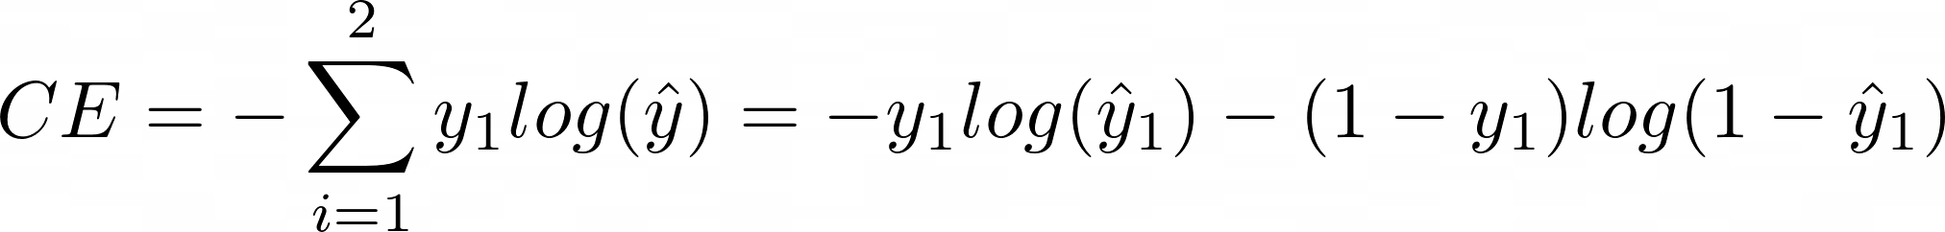
Loss function - Cross-entropy
Where C is the number of classes, y is the true value and y_hat is the predicted value.
For a binary classification task (i.e. C=2), the cross-entropy loss function becomes:

Slide 29

Build ANN Using Scikit-learn

Slide 30
Extensions to SciPy (Scientific Python) are called SciKits.
SciKit-Learn provides machine learning algorithms.
Algorithms for supervised & unsupervised learning
Built on SciPy and Numpy
Standard Python API interface
Sits on top of c libraries, LAPACK, LibSVM, and Cython
Open Source: BSD License (part of Linux)

Slide 31
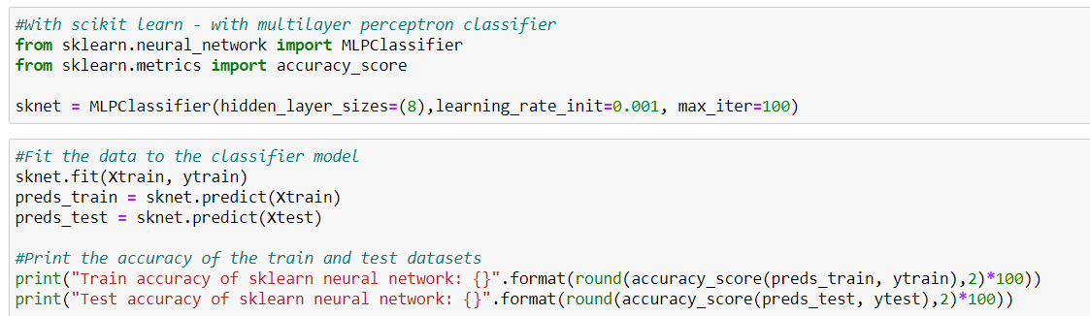
Building Model using Scikit Package
Applying same dataset over MLPClassifier under Scikit Package

Slide 32

Build ANN Using Keras

Slide 33
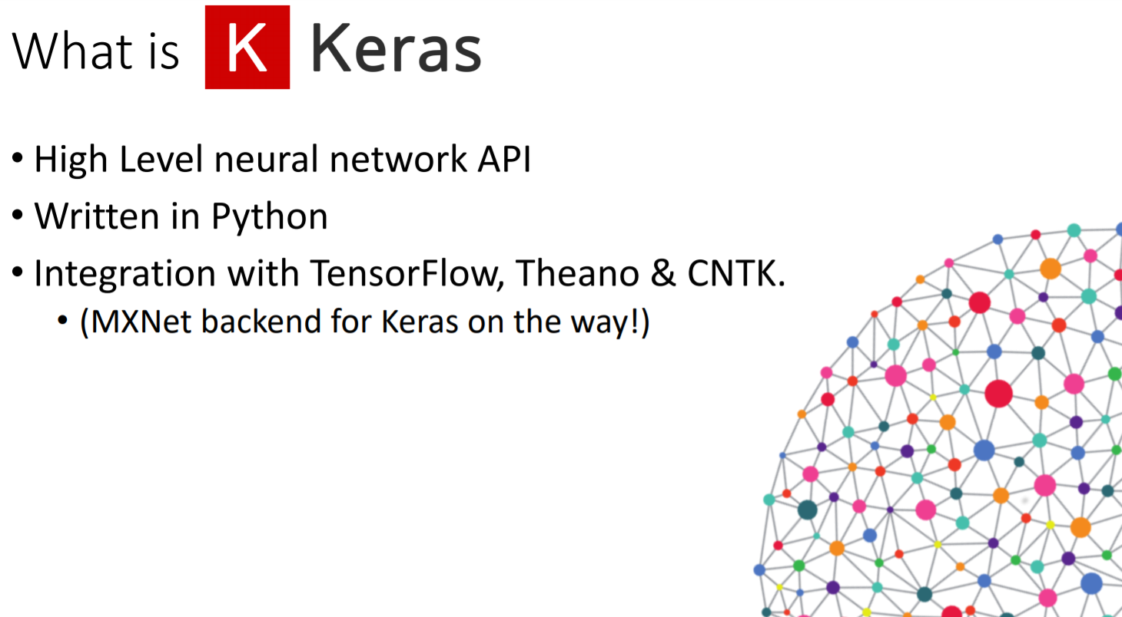

Slide 34
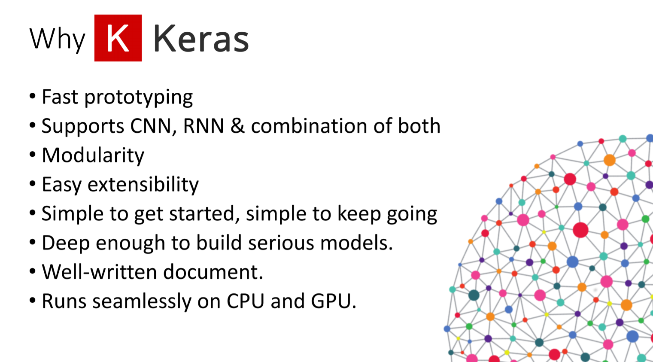

Slide 35
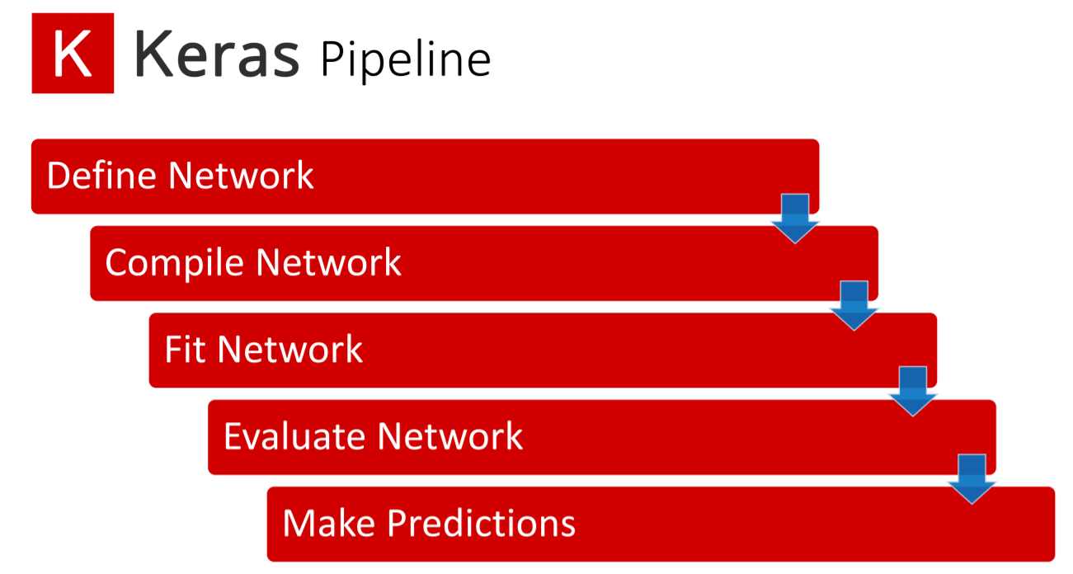

Slide 36
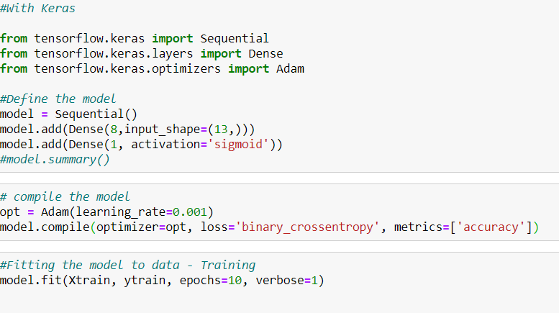
Building Model using

Slide 37
References -
Neuron - https://commons.wikimedia.org/wiki/File:Neuron.svg
Artificial Neuron - https://commons.wikimedia.org/wiki/File:Artificial_neural_network.png
Multilayer Neural Network - https://commons.wikimedia.org/wiki/File:MultiLayerNeuralNetworkBigger_english.png
Single Neuron - https://heartbeat.fritz.ai/building-a-neural-network-from-scratch-using-python-part-1-6d399df8d432
Activation Function - https://medium.com/@shrutijadon10104776/survey-on-activation-functions-for-deep-learning-9689331ba092
Forward and backpropagation - https://commons.wikimedia.org/wiki/File:Backprogation_neural_networks.png
Gradient Descent - https://www.oreilly.com/library/view/learn-arcore-/9781788830409/e24a657a-a5c6-4ff2-b9ea-9418a7a5d24c.xhtml

